Slide 1
JavaScript
Deepak H G

Slide 2
introduction
JavaScript is the most widely used programming language.
JavaScript was originally developed at Netscape by Brendan Eich, and was named as Mocha later as LiveScript.
During 1995, LiveScript became a joint venture of Netscape and Sun Microsystems and was named as JavaScript.
ECMAScript is the specification or standardization for the JavaScript language. The current standard is ECMAScript 2023 (ES14).

Slide 3
Introduction
JavaScript can be divided into 3 parts:
The core
Heart of the language.
Includes operators, expressions, statements, and subprograms.
Client side
Includes a collection of objects that support:
the control of a browser
interaction with the user
Server side
Includes a collection of objects that are useful to work on a web server.
Example: objects supporting the communication with the database management system.

Slide 4
introduction
JavaScript is the programming language that web browsers support and understand.
JavaScript is the programming language that can be used both on server side and client side of the applications.
Server Side Application – Backend logic that runs on computers in data centers and interacts with the database.
Client Side Application – Logic that runs on the device of the user.
JavaScript can be used to write varieties of applications and scripts.
JavaScript can be used for (semi) object-oriented, functional, and procedural programming.
JavaScript has a great number of libraries and frameworks. Ex. React, jQuery, Angular, Node.js.
JavaScript has a huge community of software developers.

Slide 5
Setting up the environment
Integrated Development Environment (IDE)
To write, run and debug the code.
Supports syntax highlighting and code completion.
Popular IDEs: Visual Studio Code *, Sublime Text.
Web browser
Good options are Google Chrome and Firefox.
Not Internet Explorer as it doesn't support the latest JavaScript features.
Node.js
An open-source, cross-platform JavaScript runtime environment.
Runs the V8 JavaScript engine, the core of Google Chrome browser, outside of the browser.

Slide 6
Web Browser understanding JavaScript
Web pages are written in three languages:
HTML
To define the content of the web pages.
CSS
To specify the layout of web pages. Ex. Colour, font size, font family etc.
JavaScript
To define what the web page can do and how it can interact with the user or the backend.
JavaScript is an interpreted language i.e., computer understands it while running it.
JavaScript engine is responsible for interpreting and executing the JavaScript source code.
Different browser manufacturers use their own implementation JavaScript engines. Mozilla’s JaegerMonkey, Apple’s Nitro, Google’s V8 engine and Microsoft Edge uses V8 engine.
The JavaScript source code is not directly interpreted. It is first translated into machine code and then executed.

Slide 7
Adding JavaScript to a web page
Two ways to add JavaScript to a web page:
Type the JavaScript directly in the HTML.
Linking an external file to the web page.

Slide 8
Adding JavaScript to a web page
Directly in HTML
In HTML, JavaScript code is added between <script> and </script> tags. The <script> tag declares that the following script will be executed.
Old JavaScript code may contain type attribute: <script type="text/javascript">. The type attribute is not required as JavaScript is the default scripting language in HTML.
The <script> tag can be placed in the <body> or in the <head> or in both sections of the HTML page.

Slide 9
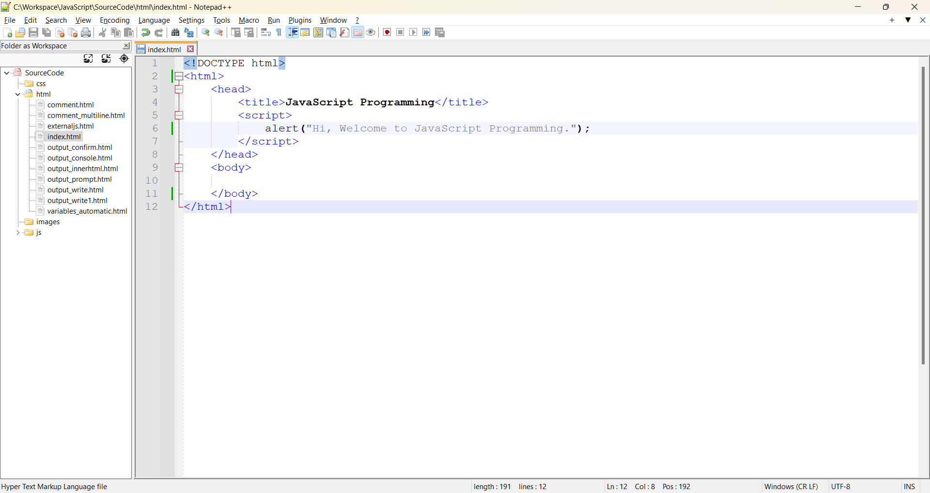
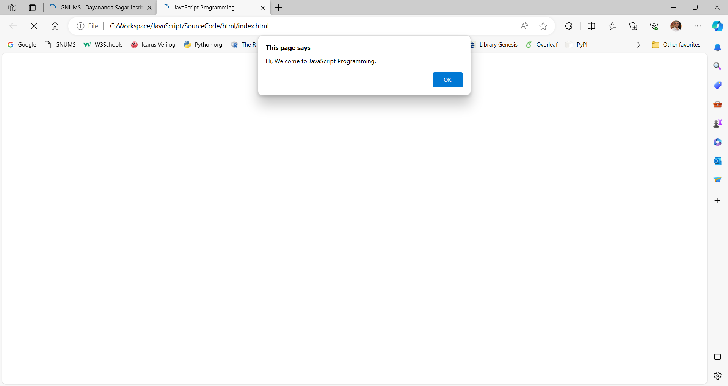
Adding javascript in html
Adding <script> tag in the <head> section

Slide 10
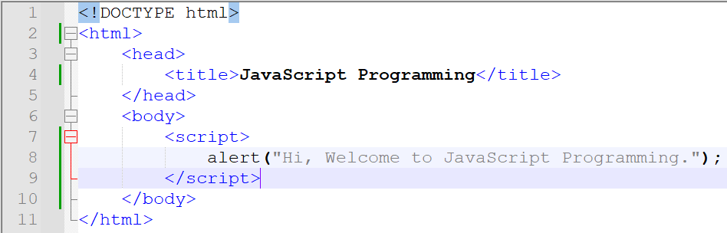
Adding javascript in html
Adding <script> tag in the <body> section
Placing the <script> tag at the bottom of the <body> element improves the display speed as the script interpretation slows down the display.

Slide 11
Adding javascript in html
External JavaScript file
Scripts can also be placed in external files.
JavaScript files have the extension .js.
External scripts are useful when same code is used in many different web pages.
Add the name of the script file in the src attribute of <script> tag.
External scripts cannot contain <script> tags.
Place an external script reference in <head> or <body>.

Slide 12
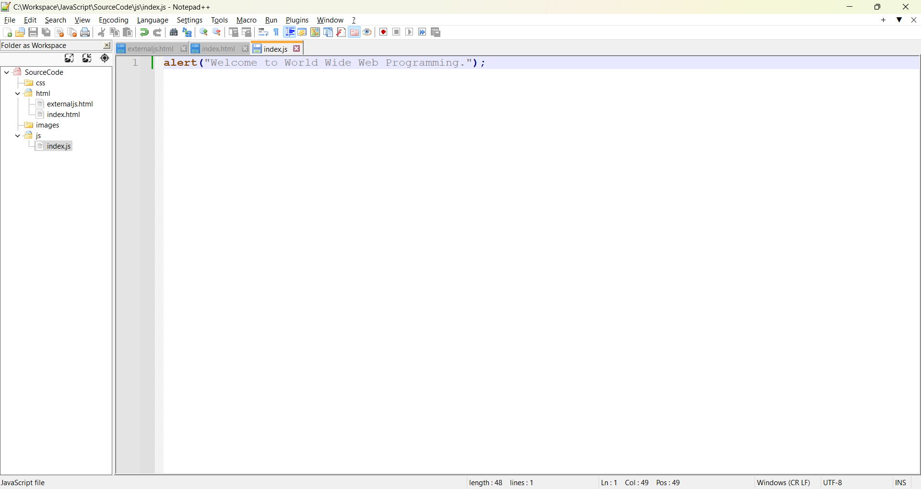
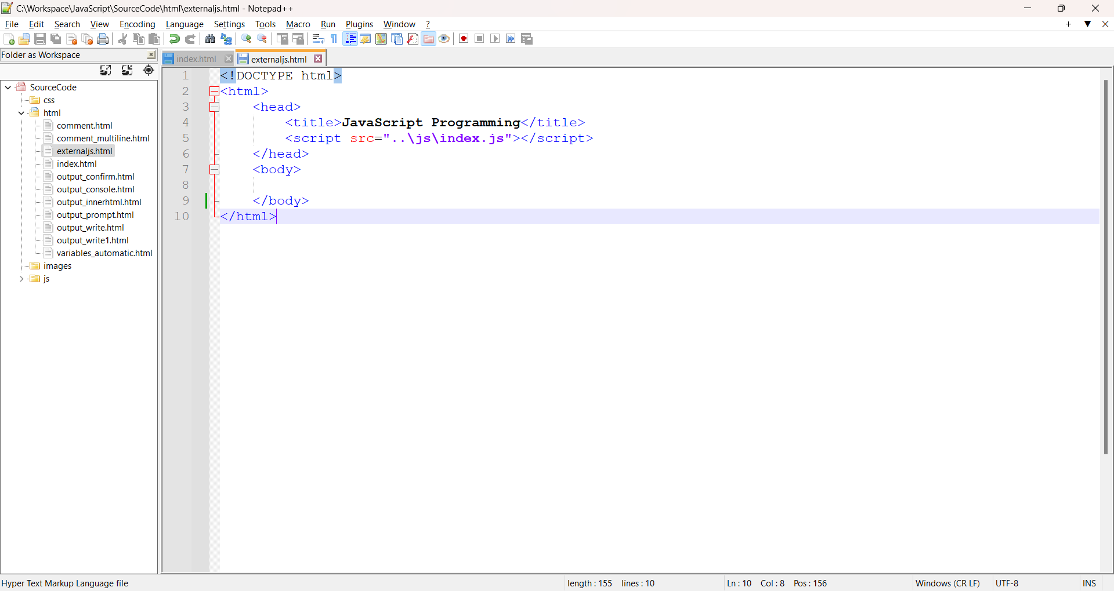
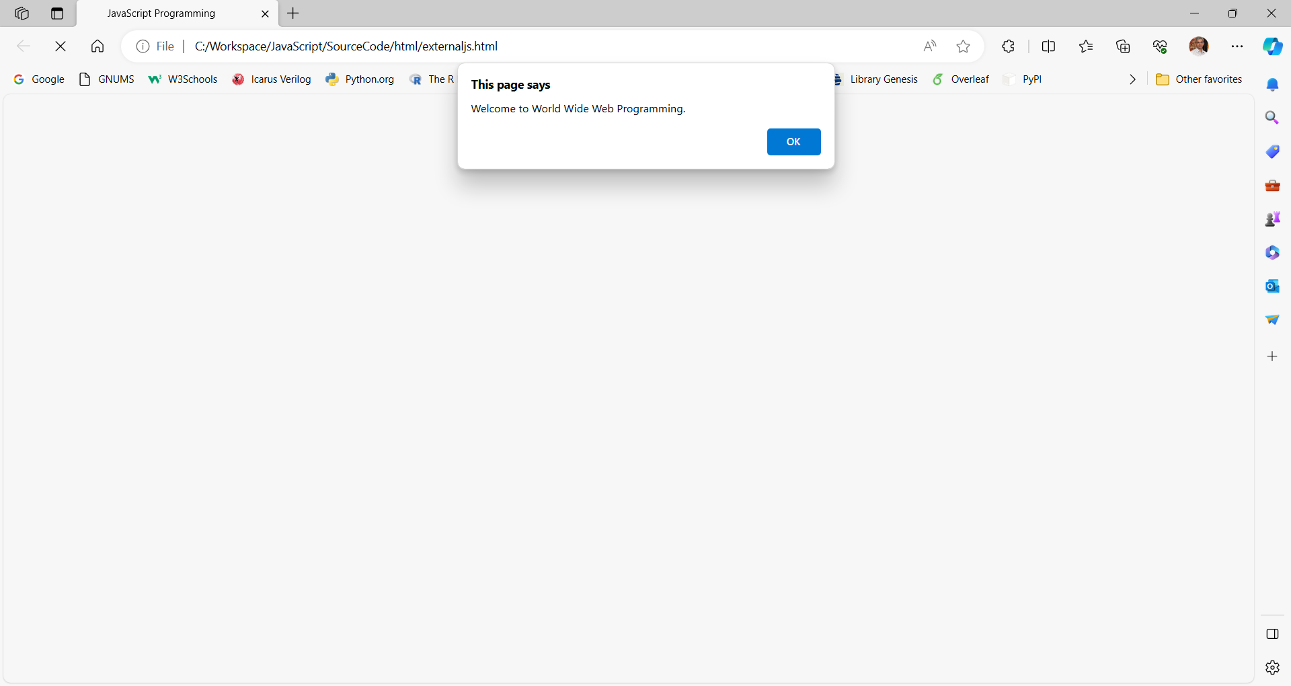
Adding javascript in html
External JavaScript file
HTML file

Slide 13
Adding javascript in html
Advantages of external JavaScript files:
Separates the HTML and the code.
Makes HTML and JavaScript easier to read and maintain.
Cached JavaScript files can speed up page loads.

Slide 14
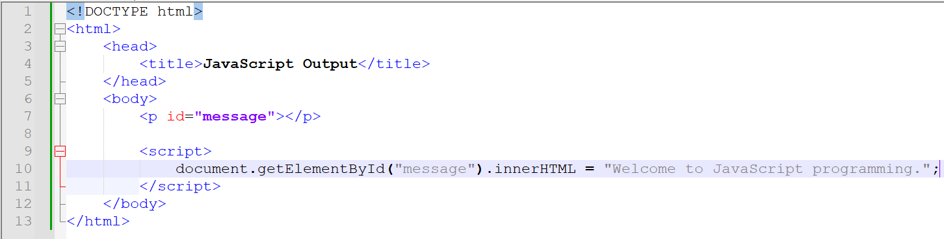
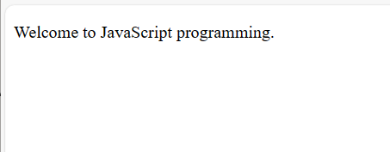
JavaScript Output
Using innerHTML property
To access an HTML element use document.getElementById(id) method.
The id corresponds to the id attribute of the HTML element.
The innerHTML property defines the HTML content.

Slide 15
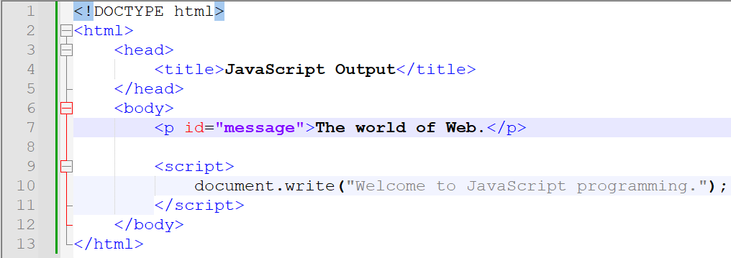
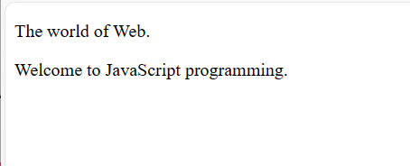
JavaScript Output
Using document.write()
Use only for testing.
Deletes all existing HTML, if used after an HTML document is loaded.

Slide 16
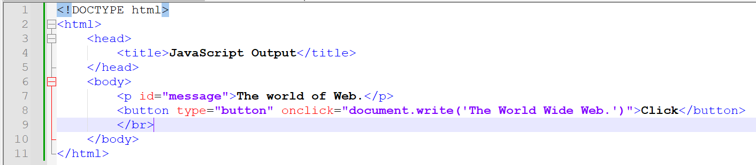
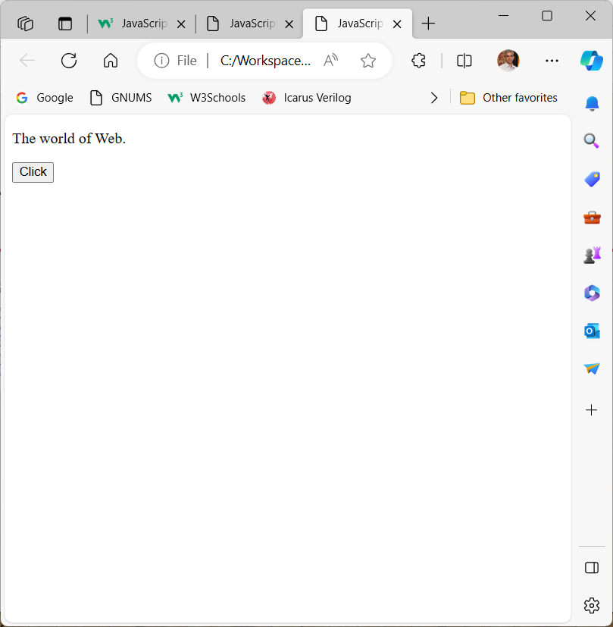
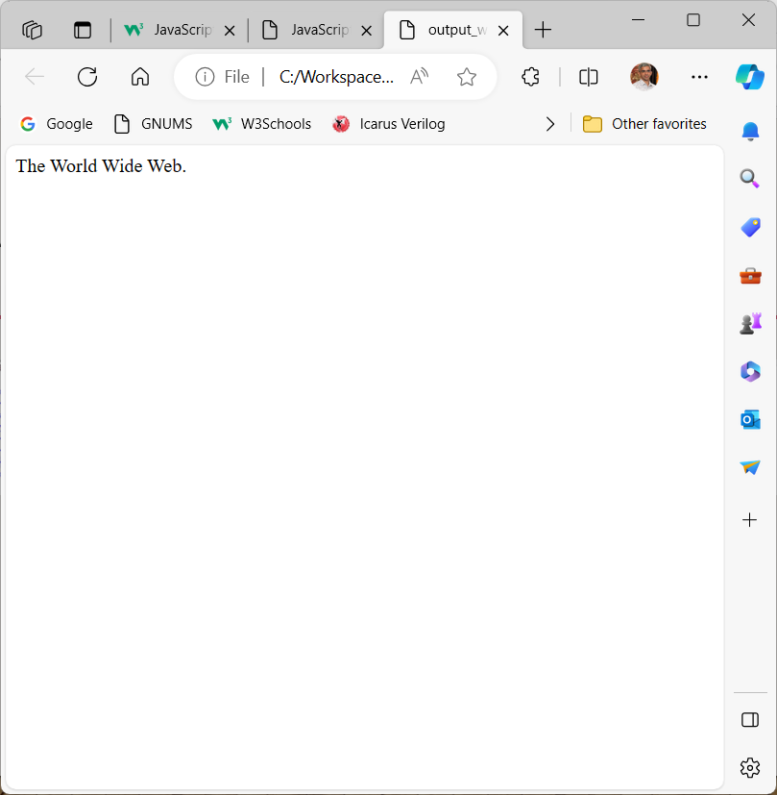
JavaScript Output

Slide 17
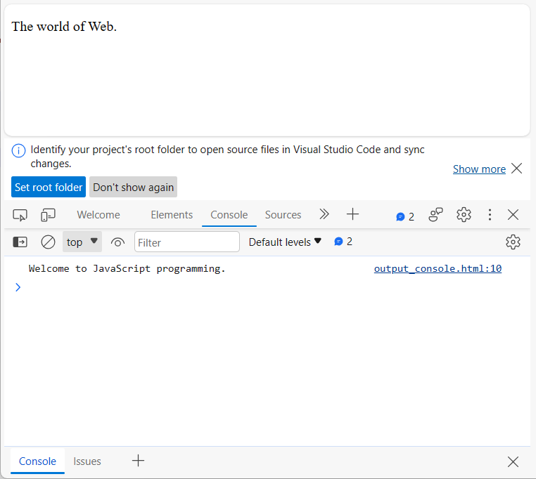
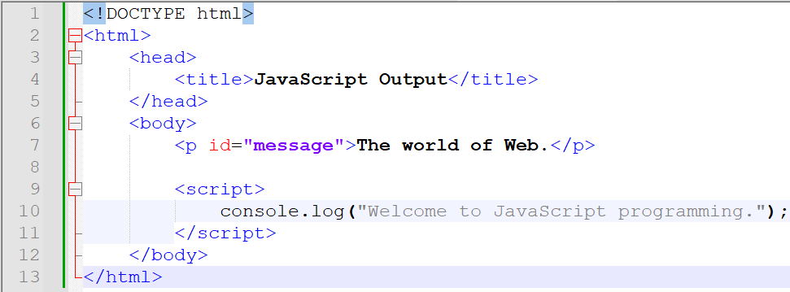
JavaScript Output
Using console.log()
Use for debugging purpose.

Slide 18
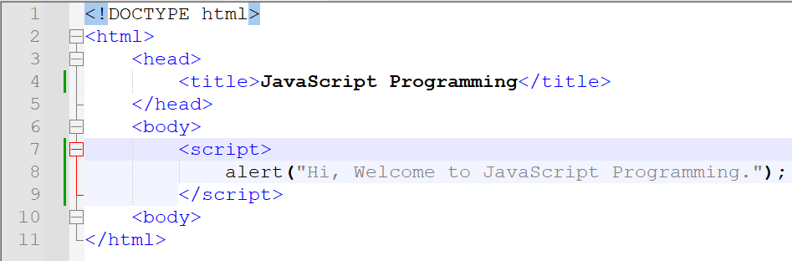
JavaScript Output
Using window.alert method
Opens a dialog window and displays its parameter in that window. Also displays an OK button.
The window word is optional. It refers to the window object. The Window object is the JavaScript model for the browser window.

Slide 19
JavaScript Output
Using window.confirm method
Opens a dialog window and displays its parameter in that window.
Also displays OK and Cancel buttons.
window. confirm() returns a Boolean value that indicates the user’s button input: true for OK and false for Cancel.
Used to offer the user the choice of continuing some process.

Slide 20
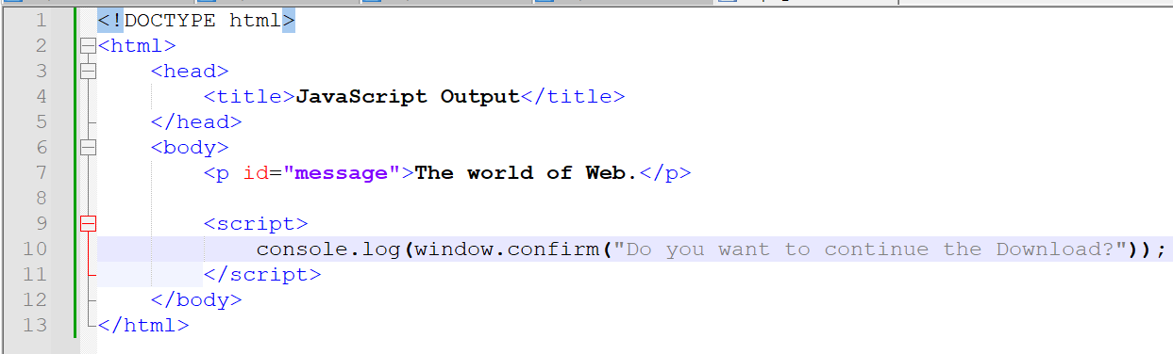
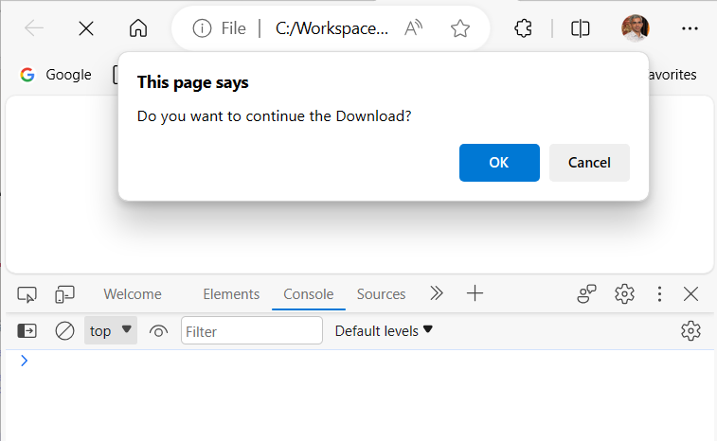
JavaScript Output

Slide 21
JavaScript input
Using window.prompt method
Opens a dialog window that contains a text box to collect a string input from the user, which is returned as its value.
Also displays OK and Cancel buttons.
The method takes two parameters: the string that prompts the user for the input and a default string, in case the user does not type a string before pressing one of the two buttons.

Slide 22
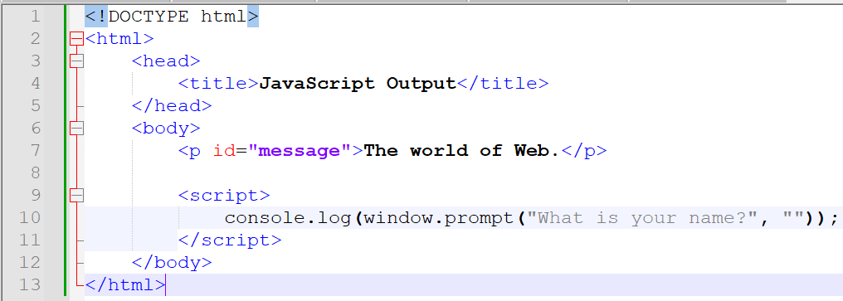
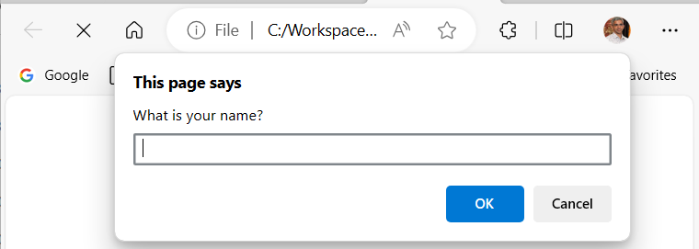
JavaScript input
alert, prompt, and confirm cause the browser to wait for a user response. In the case of alert, the OK button must be clicked for the JavaScript interpreter to continue. The prompt and confirm methods wait for either OK or Cancel to be clicked.

Slide 23
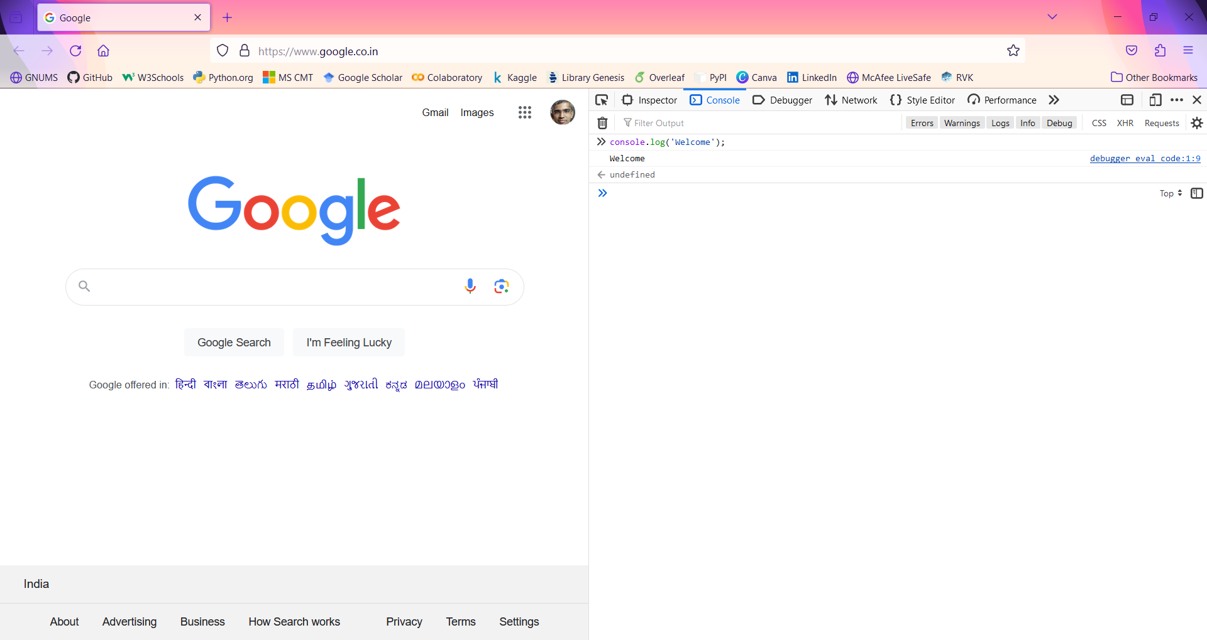
Browser console
Web browsers have an option to see the code that makes the web page.
Press ctrl + shift + I or right-click and select Inspect on the browser. Click on the Console tab.

Slide 24
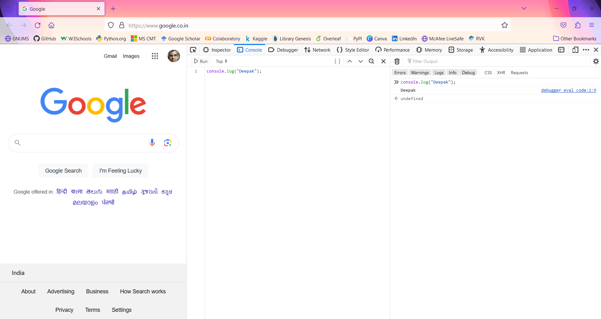
Browser console – Mozilla Firefox
Click on the console tab. Some code can be added directly here.
The console is used by developers to log what is happening in a web page and to debug.
Debug is finding the problem when an application is not functioning as desired.
We will use concole.log() to test the code and see the results.

Slide 25
Browser console – Mozilla Firefox
Type 7 + 3, and press Enter.
Type console.log(“Welcome to JavaScript programming.”); and press Enter.
Click the button to clear the console.

Slide 26
NOde.js
Node.js was originally developed by Ryan Dahl, a PhD student in mathematics.
In January 2009, Ryan Dahl began working on the implementation for server-side JavaScript.
In September 2009, Isaac Schlueter started working on a package manager for Node.js, the Node Package Manager (npm).
The platform is lightweight and can be installed on almost any system.
Node.js applications also omit a heavyweight development process.
Node.js uses the same JavaScript engine as Google Chrome i.e., V8 engine.
Node.js is an open-source project.

Slide 27
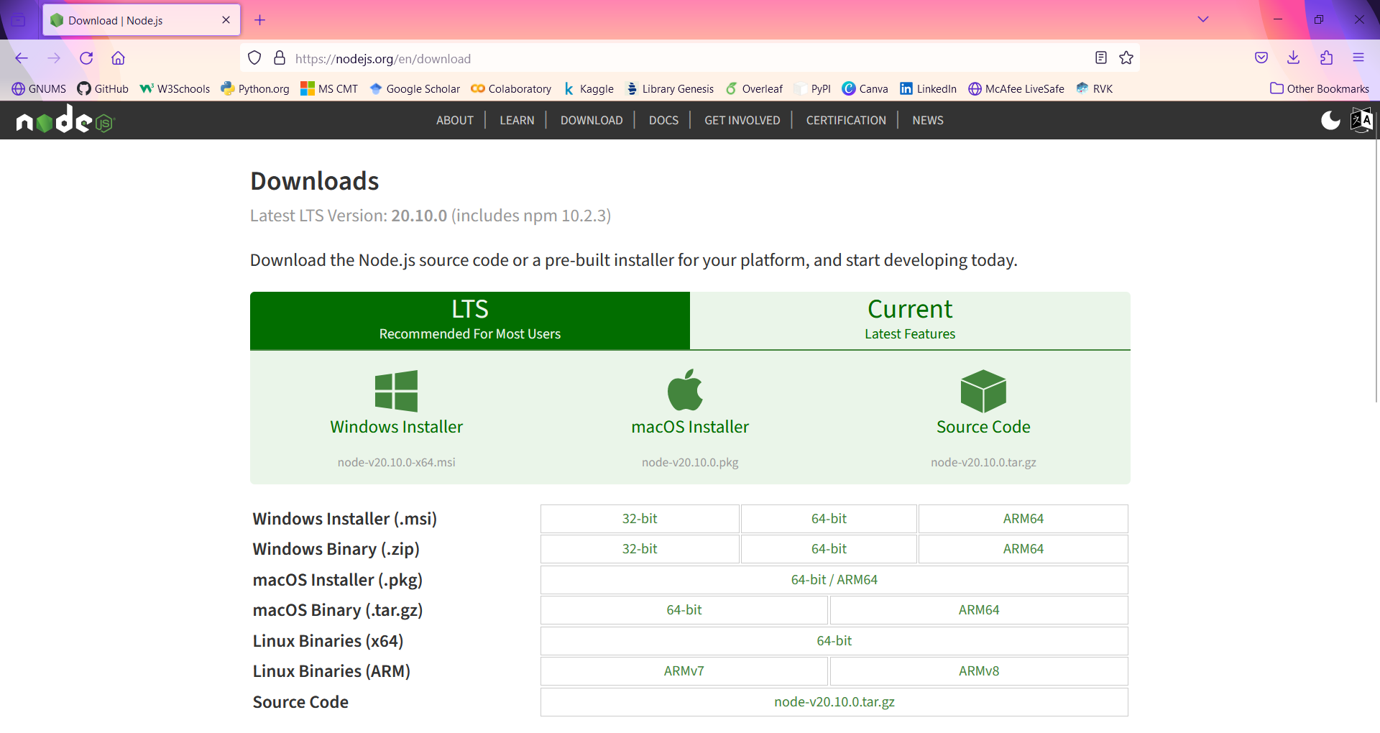
Node.js
Installation
Node.js can be installed on Unix-based systems like Linux or macOS and Windows.
Node.js version number consists of three parts: major release, minor release and patch level.
Major release as even number indicates Long Term support and odd versions have a shorter life span.
On Linux
wget https://nodejs.org/dist/v16.8.0/node-v16.8.0-linux-x64.tar.xz
$ cd /opt
$ sudo tar xvf ~/node-v16.8.0-linux-x64.tar.xz
$ sudo ln -s node-v16.8.0-linux-x64 nodejs
$ PATH=$PATH:/opt/nodejs/bin
$ export PATH
gedit /etc/profile
source /etc/profile
OR sudo apt-get install nodejs
node –v
For Windows
https://nodejs.org/en/download

Slide 28
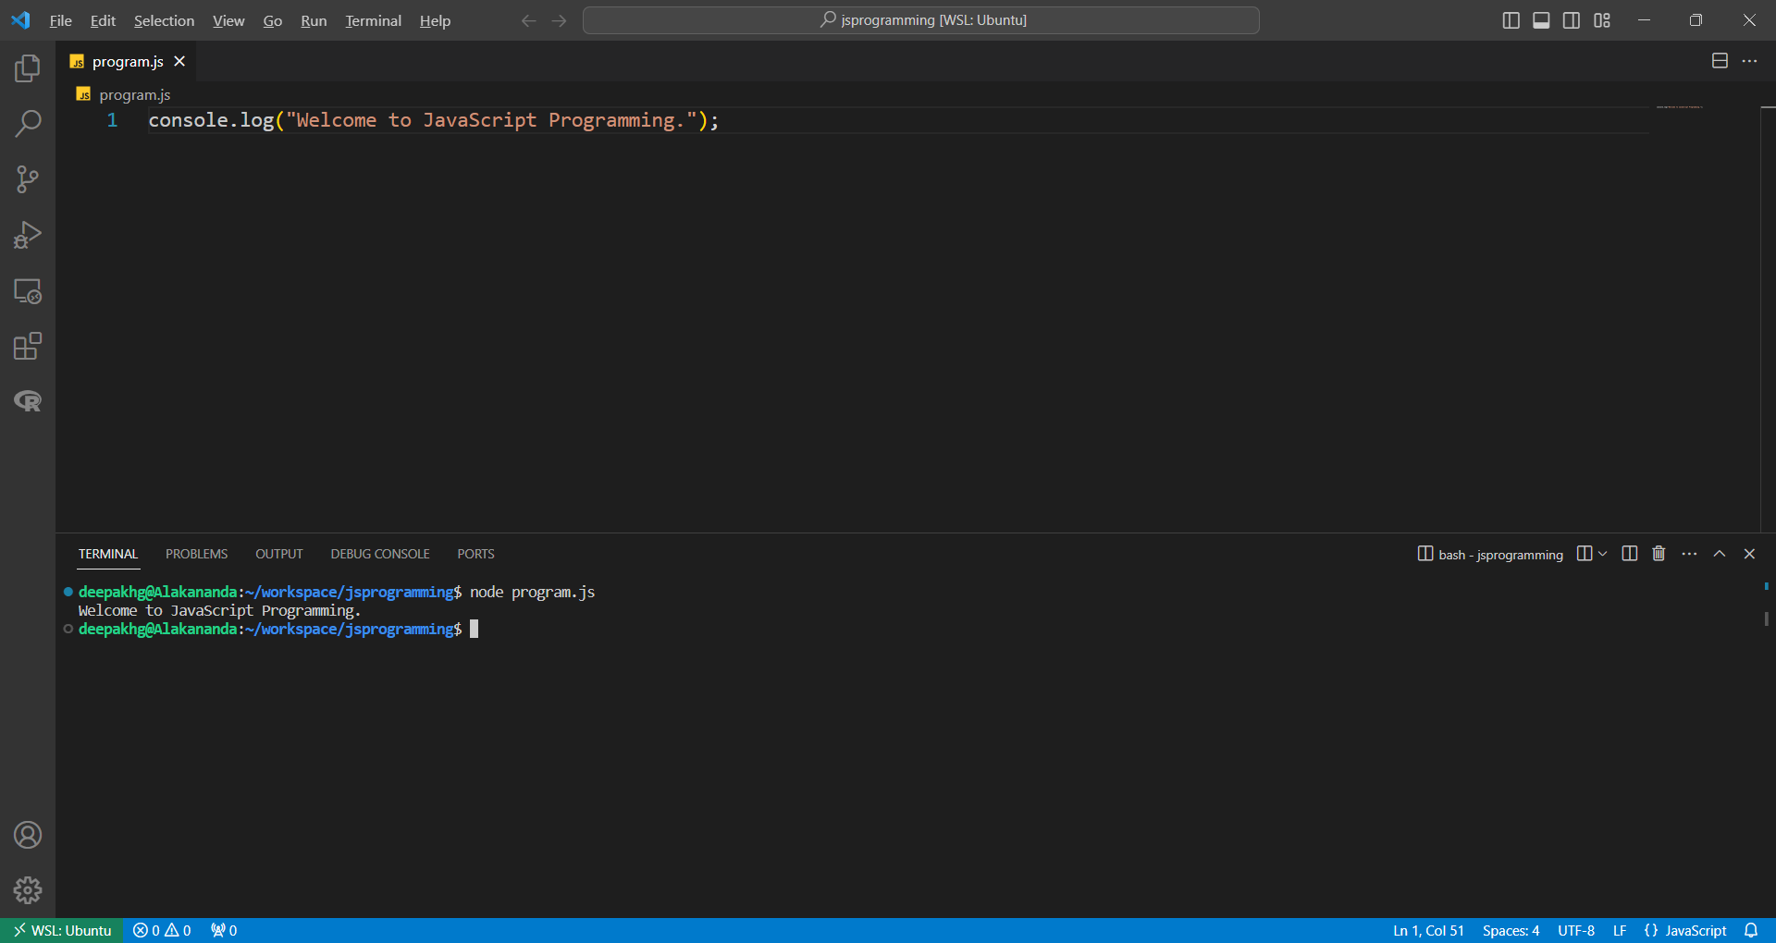
Executing JAVASCRIPT CODE on Node.js
Create a file with extension .js
Execute the code using the command node <fileName>.js

Slide 29
Writing JavaScript Code
Important things while writing JavaScript code:
Indentations
Whitespace
Insert a semicolon after every statement.
Comment the code
Single-line comments
// single line comment
Multi-line comments
/* Multi-line comment.
This line is not executed.
*/

Slide 30
Variables
Variables are values in the code that can represent different values each time the code runs.
Variables are declared using the keyword:
let
var
const
A variable definition consists of three parts:
A variable-defining keyword (let, var, const)
A name
A value

Slide 31
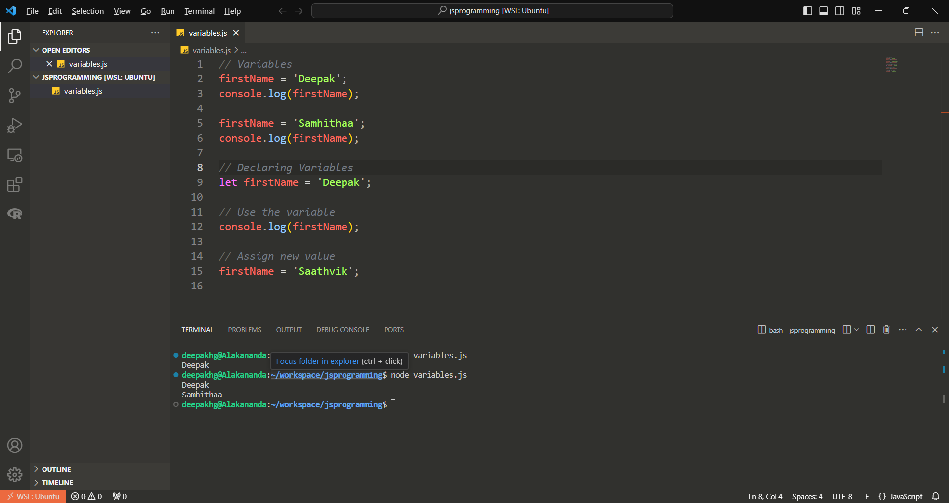
Declaring Variables
Declare the variable for the first time it is created.
Use the name to call or assign a new value to the variable.

Slide 32
Declaring Variables
Difference between let, var and const:
Global scope
Can use the variable in the entire script.
Block scope
Can use the variables in the specific block in which they are define. A block of code always starts with { and end with }.
let | var | const
Use for variables that might have new value assigned in a program. | Use for variables that might have new value assigned in a program. | Use for variables that get a value assigned once.
Has block scope. | Has global scope. | Has block scope.

Slide 33
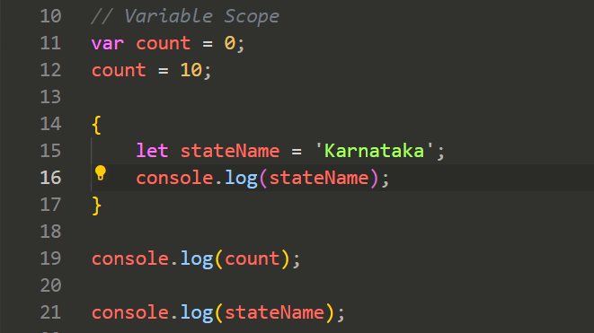
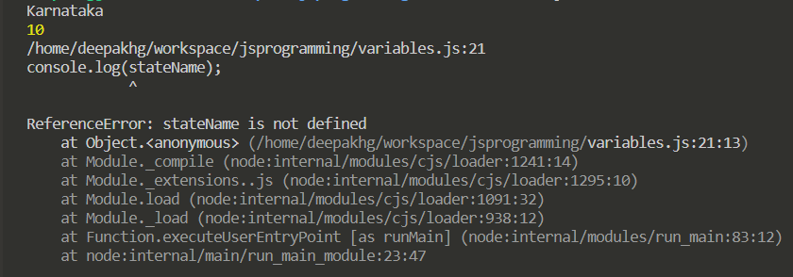
Declaring Variables

Slide 34
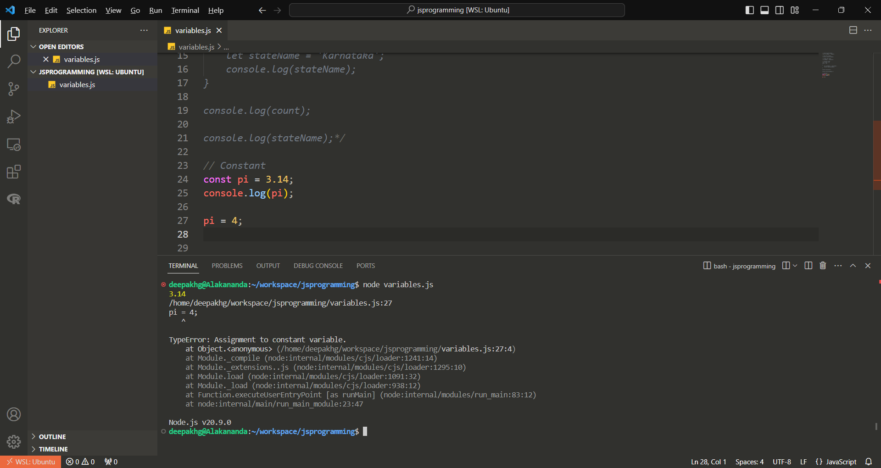
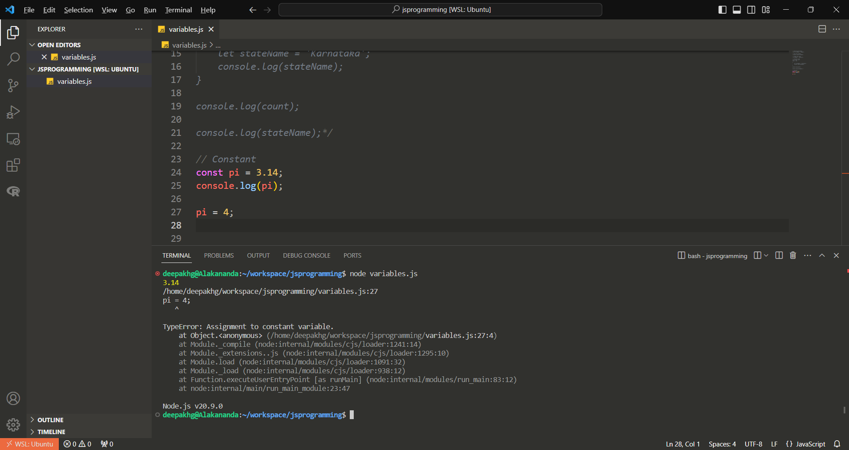
Declaring Variables
Use of const:

Slide 35
Naming Variables
Variable name start with a lower case letter.
Variable name should be descriptive.
If a variable holds an age, name it as age not x.
Variable name can’t contain spaces but can use underscore.
JavaScript uses camel case to name variables.
When a variable use multiple words, start with a lowercase word, then use a capital for every new word after the first word.

Slide 36
Primitive Data Types
Variables can be assigned with a different types of values.
JavaScript is a loosely typed language. The type doesn’t need to be named explicitly.
JavaScript determines the variable type based on the value assigned.
JavaScript has seven primitive types:
String
Number
BigInt
Boolean
Symbol
undefined
null

Slide 37
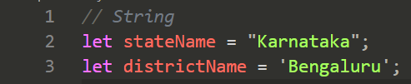
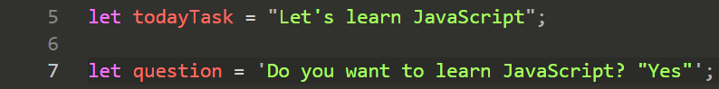
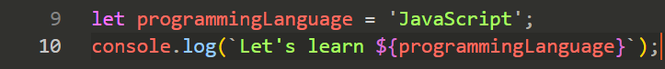
Primitive Data Types
String
A string is a sequence of characters.
Declaring a string:
Double quotes
Single quotes
Backticks

Slide 38
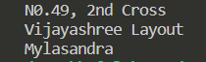
Primitive Data Types
Escape characters
“Do not take the next character as you normally would”.

Slide 39
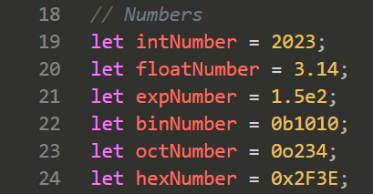
Primitive Data Types
Number
Used to represent numbers.
Can store larger numbers, signed numbers, unsigned numbers, integers and floating point numbers.
Number range between 2⁵³ – 1 and –(2⁵³ – 1).

Slide 40
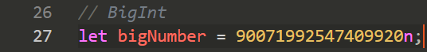
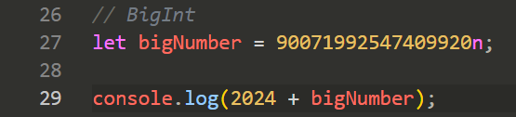
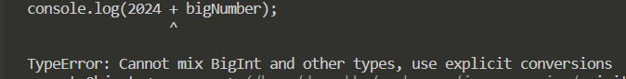
Primitive Data Types
BigInt
To store numbers above 2⁵³ – 1 and below –(2⁵³ – 1).
Postfix the value by n.
Important:

Slide 41
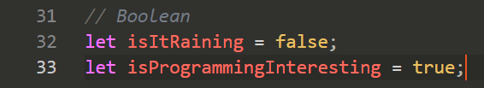
Primitive Data Types
Boolean
Can hold two values: true and false.

Slide 42
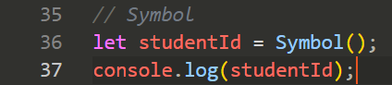
Primitive Data Types
Symbol
Represents a unique identifier.
Primarily used for object properties.

Slide 43
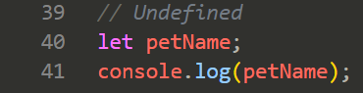
Primitive Data Types
undefined
Variable not been assigned a value.

Slide 44
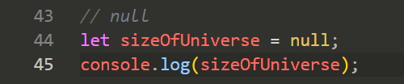
Primitive Data Types
null
A variable is empty or has an unknown value.

Slide 45
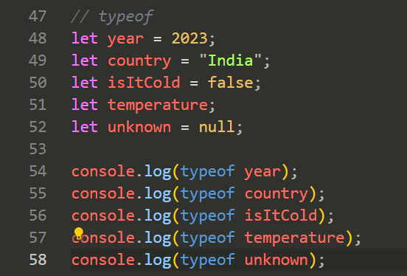
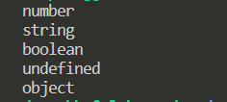
Type of a variable
typeof
typeof null is object is a bug existing since forever and now can’t be removed due to backward compatibility problem.

Slide 46
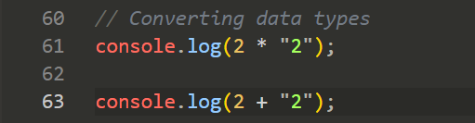
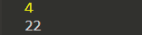
Converting Data Types
+ is used to concatenate strings.
Built-in data type conversion methods
String()
Number()
Boolean

Slide 47
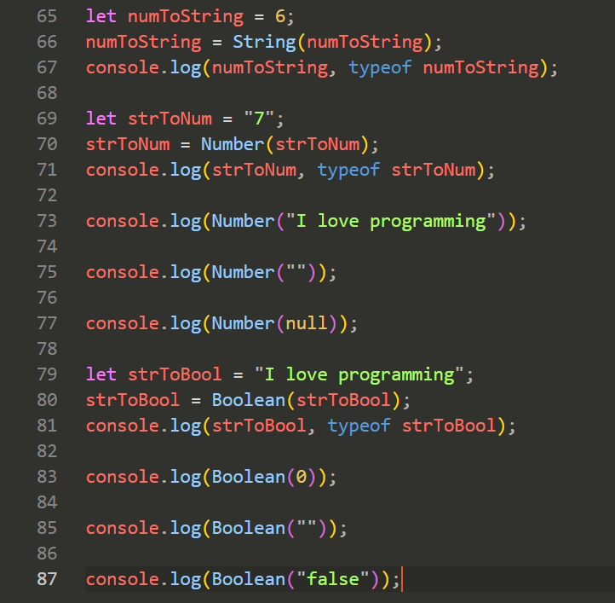
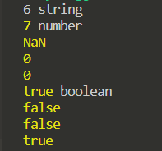
Converting Data Types

Slide 48
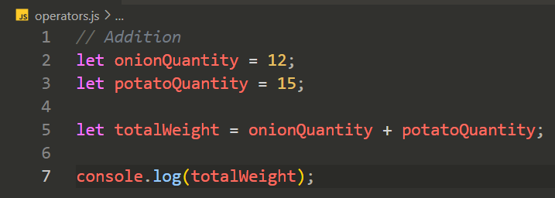
Arithmetic Operators
Addition
Use + for addition operation.

Slide 49
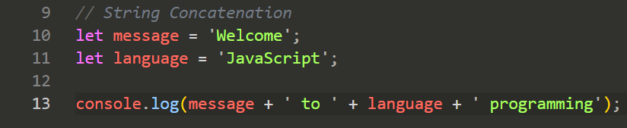
Arithmetic Operators
Addition

Slide 50
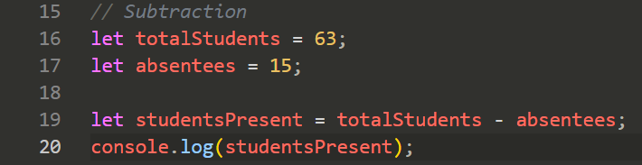

Arithmetic Operators
Subtraction
Use - for subtraction operation.

Slide 51


Arithmetic Operators
Multiplication
Use * for multiplication operation.

Slide 52

Arithmetic Operators
Division
Use / for division operation.

Slide 53

Arithmetic Operators
Exponentiation
Use ** for exponentiation operation.

Slide 54

Arithmetic Operators
Modulus
Use % for modulus operation.

Slide 55




Arithmetic Operators
Unary Operators
Operators need only one operand.

Slide 56
Arithmetic Operators
Operator Precedence
If operators with equal precedence exists then operation takes place from left to right.
Name | Symbol
Grouping | (…)
Exponentiation | **
Prefix increment and decrement | ++, --
Multiplication, Division, Modulus | *, /, %
Addition, Subtraction | +, -

Slide 57




Assignment Operators
= is used for assignment operation.

Slide 58
Comparison Operators
The outcome of the comparison operators is always a Boolean i.e., true or false.

Slide 59
Comparison Operators
Equal
Determines whether two values are equal.
Two flavours:
Equal by value only
Equal by value and data type

Slide 60




Comparison Operators
Equal by value only
== is the operator.
Returns true when the values are equal.

Slide 61


Comparison Operators
Equal by value and data type
=== is the operator.
Returns true when the value and the data type are the same.

Slide 62


Comparison Operators
Not equal by value
!= is the operator.
Returns true when the values are not equal and false when values are equal.

Slide 63


Comparison Operators
Not equal by value and data type
!== is the operator.
Returns false when the value and the data type are the same.

Slide 64

Comparison Operators
Greater than
> is used for the greater than comparison.
Returns true if the left-hand side is greater than the right hand
side of the operation.
Greater than or equal to
>= is used for the greater than or equal to comparison.
Returns true if the left-hand side is greater than or equal to the
right-hand side.

Slide 65

Comparison Operators
Smaller than
< is used for the smaller than comparison.
Returns true if the left-hand side is smaller than the right hand
side of the operation.
Smaller than or equal to
<= is used for the smaller than or equal to comparison.
Returns true if the left-hand side is smaller than or equal to the
right-hand side.

Slide 66
Comparison Operators
Operation | Operator
Is equal to | ==
Is not equal to | !=
Is less than | <
Is strictly equal to | ===
Is strictly not equal to | !==
Is greater than | >
Is less than or equal to | <=
Is greater than or equal to | >=

Slide 67
Logical Operators
Used to check two conditions in one or to negate a condition.
Ex. X is greater than Y and Y is greater than Z.
Logical operators include:
and (&&)
or (||)
not (!)

Slide 68


Logical Operators
AND
&& is the operator.
Returns true only if both the expressions are true.

Slide 69


Logical Operators
Or
|| is the operator.
Returns true if either one of the expressions is true.

Slide 70


Logical Operators
Not
! Is the operator.
Used to negate a Boolean. Can also negate an expression that evaluates to a Boolean.

Slide 71
Logical Operators
Operation | Operator
Logical AND | &&
Logical OR | ||
Logical NOT | !

Slide 72
Arrays
An array is a list of values.
The values can be of all data types.
One array can contain values of different data types.
The values are accessed by referring to an index number.

Slide 73

Creating Arrays
Method 1

Slide 74

Creating Arrays
Method 2

Slide 75

Creating Arrays
Method 3
Creates an array with 10 undefined values.

Slide 76

Creating Arrays

Slide 77

Creating Arrays
Method 4

Slide 78

Creating Arrays
Mixed array

Slide 79

Creating Arrays
Declaring an array using const
A new value can be assigned to the array element not to the full array.

Slide 80

Accessing Elements
The array element is accessed by referencing the array’s index.
During creation, JavaScript assigns an index to every value of the array.
The first value is assigned the position of 0, the second 1 and so on.

Slide 81

Changing an Array Element
The elements in an array can be overwritten (changed).

Slide 82

Changing an Array Element
Not the right way to add values to the array.

Slide 83

Arrays are Objects
Arrays are special type of objects.
The typeof operator in JavaScript returns object for arrays.

Slide 84


Array Properties
Properties are values of an object.
The length property.
Returns the number of values that the array has.

Slide 85

Array Properties
Accessing the last element in the array.
Last element index = length – 1.

Slide 86
Array Methods
Methods are functions on an object.
Methods perform an action.

Slide 87

Adding elements to an array
push() method
The new value gets added to the end of the array.
The push() method returns the new length of the array.

Slide 88


Adding elements to an array
splice() method
To add an element at a specified index.
The method takes 2 parameters:
Index of the array on which we want to insert.
Number of elements to be deleted starting at the index.
The new elements to be inserted.

Slide 89

Adding elements to an array
concat() method
To add an array to the existing array.

Slide 90

Adding elements to an array
unshift() method
To add a new element at the beginning of an array.

Slide 91

Deleting ARRAY elements
pop() method
To remove the last element of an array.

Slide 92

Deleting ARRAY elements
shift() method
To delete the first element of the array.
Shifts all other elements to a lower index.

Slide 93

Deleting ARRAY elements
splice() method
To add an element at a specified index.
The method takes 2 parameters:
Index of the array on which we want to insert.
Number of elements to be deleted starting at the index.
The new elements to be inserted.

Slide 94

Deleting ARRAY elements
delete
Change the value of a certain position of the array to undefined.

Slide 95

Array to String
toString() method
Joins all the array elements into a string, separated by comma.

Slide 96

Array to String
join() method
Joins all the array elements into a string, separated by comma.
The separator can be specified.

Slide 97

Reversing ARRAY ELEMENTS
The elements of the array are reversed.
reverse() method.

Slide 98

Sorting ARRAY ELEMENTS
Sorts numbers from small to high and strings from A to Z.
sort() method

Slide 99

Array Methods
slice() method
Slices out a part of an array.
Takes 2 arguments: start and end.
Selects elements from start argument up to the end argument (excluding).
If the end argument is omitted, it slices out the rest of the array.

Slide 100
Array Methods
find() method
To check whether a value is present in an array.

Slide 101


Array Methods
indexOf() method
To find the position of an element in an array.
Returns the index on which the value is found.
If a value occurs in an array more than once, it will return the first occurrence.
If the value is not found, it will return -1.

Slide 102


Array Methods
lastIndexOf() method
To find the last position of an element in an array.

Slide 103

Multidimensional Arrays
Arrays can contain any data type.
Arrays can also contain other arrays. This is called a multidimensional array.

Slide 104

Objects
Used to describe real-life objects.
Objects have:
Properties.
Methods (actions that they can perform).
Example: Dog
Properties:
Name - Gopi
Colour - Brown
Breed – Golden Retriever

Slide 105

Objects
Object Creation with properties

Slide 106

Objects
Accessing the properties of an object

Slide 107


Objects
Updating objects
Change the value of the properties of the object

Slide 108


Objects
Deleting the property of the object

Slide 109

Objects
Object Methods
Methods are actions performed on objects.
Methods are stored in properties as function definitions.
this keyword refers to an object.

Slide 110
Logical Statements
Logical (Control) statements allow us to make multiple paths in our code.
Depending upon the outcome of a condition, we will follow one code path or another.
Logic (Control) statements:
if and if else statements
else if statements
Conditional ternary operators
switch statements

Slide 111

If and if else statements
If some condition is true, then a certain action will happen else another action will happen.

Slide 112

Else if statements

Slide 113

Conditional Ternary Operator
A ternary operator has 3 operands.
Operand1? Operand2: Operand3;
expression ? statement for true : statement associated with false;

Slide 114
Switch statement
Useful when evaluating more number of conditions.
Syntax
switch (expression) {
case value1:
// Code to be executed.
break;
case value2:
// Code to be executed.
break;
default:
// Code to be executed when no cases match.
break;
}

Slide 115

Switch statement
If expression equals value1, execute the code specified for that case. If expression equals value2, execute the code specified for that case, and so on.
If we don’t use the break command, the next case statement will also be executed.
switch uses strict type checking (the triple equals strategy) to determine equality, which checks for both a value and a data type.

Slide 116

Switch statement
Combining cases
Useful when same code to be executed for multiple cases.

Slide 117
Loops
Loops execute a code block a certain number of times.
Used to:
Repeat operations
Iterate over data sets, arrays and objects
Loops
while loop
do while loop
for loop
for of loop
for in

Slide 118
While loops
A while loop executes a certain block of code as long as an expression evaluates to true.
Syntax
while (condition) {
// Code to be executed
}
If the condition is false, the code inside the block will be skipped.

Slide 119


While loops
Loop gets stuck in an infinite loop if counter is not incremented.

Slide 120
Do while loops
Used when a code block to be executed at least once.
Example:
User validation
Connecting to the database
Syntax
do {
// Code to be executed
} while (condition);
The code within the do block executes first and then the condition is evaluated. If the condition is true, the code in the do block is executed. It will continue until the condition changes to false.

Slide 121

Do while loops
Loop gets stuck in an infinite loop if number is not incremented.

Slide 122
For loops
Syntax
for (initialize variable; condition; statement) {
// Code to be executed
}
The parentheses following for has 3 parts, separated by semi-colons:
Initialize – Initialize a variable that can be used in the loop.
Condition – The loop keeps iterating as long as the condition is true. The condition is checked after initializing the variable before the first iteration.
Statement – Executed after every iteration.

Slide 123

For loops
Loop gets stuck in an infinite loop if number is not incremented.

Slide 124
Nested loops
A loop inside a loop is called a nested loop.
Syntax
while (condition 1) {
// Code executed as long as condition 1 is true
while (condition 2) {
// Code executed as long as condition 2 is true
}
}
Nesting can be used with all types of loops.
Nesting can go several levels deep.

Slide 125

Nested loops

Slide 126


Loops and Arrays

Slide 127
For of loop
Useful to iterate over the elements of an array.
It can’t be used to change the value associated with the index.
Syntax
let names = [];
for (let variableName of names) {
// Code to be executed
}
Value of the variableName gets updated at every iteration.

Slide 128

For of loop

Slide 129


For in loop
Used to list the properties of an object.
Syntax
for (let variableName in object) {
// Code to be executed
}

Slide 130


Break
break
Used to control the flow of execution of the loop.
break stops the loop and the execution moves to the code below the loop.

Slide 131


continue
continue
Used to control the flow of execution of the loop.
continue stops the current iteration and moves back to the top of the loop, checking the condition and start a new iteration.

Slide 132
Functions
Functions are actions.
Functions contain a bundle of statements that can be executed when the function is called.
Functions reduce the amount of code needed in the applications.
Example: alert(), confirm(), prompt(), push()

Slide 133
Functions
Writing Functions
Syntax:
function nameOfTheFunction() {
// Content of the function
}
Invoking Functions
nameOfTheFunction();

Slide 134


Functions

Slide 135

Functions
Variable containing a function

Slide 136
Functions
Naming functions
Use camelCase to name the function.
Name of the function should describe what the function is doing.
Example: addNumbers() instead 0f myFunc()
Use a verb to describe what the function is doing. (Function name to start with an action word).
Example: sayHi() instead of hi()

Slide 137
Functions
Parameters and arguments
Information that is passed into a function.
A parameter is defined as the variable listed inside the parentheses of the function definition, which defines the scope of the function.
Syntax
function nameOfTheFunction(param1, param2) {
// Content of the function
}
nameOfTheFunction(arg1, arg2);

Slide 138


Functions
Depending on the arguments, the outcome of the function changes.

Slide 139

Functions
Default parameters
JavaScript gives the variables a default type undefined.
Undefined + undefined = NaN

Slide 140


Functions
Default parameters

Slide 141


Functions
Arguments more than the parameters

Slide 142
Functions
Arrow functions
Shorthand notation for writing functions.
Useful to write an implementation inside another function as an argument.
Most often used for functions that consists of only one statement.
Syntax
No parameters
() => body of the function;
One parameter
param => body of the function;
Two parameters
(param1, param2) => body of the function;
Multiline function
(param1, param2) => {
//Body of the function
}
If no parameter, must use the parentheses.

Slide 143


Functions

Slide 144

Functions

Slide 145


Array Method
foreach
Executes a function for every element in the array.

Slide 146
functions
Returning function values
Functions give back a result to the function’s caller when a return value is specified.
Syntax
function nameOfTheFunction(param1, param2) {
// Content of the function
return value;
}

Slide 147


functions
return ends the function and sends back whatever value comes after it.

Slide 148


Functions
Returning arrow function values
From a one-line arrow function, the value can be returned without using the return.
From a multi-line arrow function, the value can be returned using the return.

Slide 149
Functions
Variable scope in functions
Scope defines range of statements over which a variable can be accessed.
In scope – Variable can be accessed.
Out of scope – Variable can’t be accessed.
Local variables
The scope of the local variables is restricted to within the functions they are defined.
The function parameters are also local variables.

Slide 150


Functions
Local variables

Slide 151


Functions
Local variables

Slide 152



Functions
let/const Vs var variables
var is function-scoped i.e., available anywhere in the function block.
let/const is not function-scoped but it is block-scoped.

Slide 153


Functions
let/const Vs var variables
Variables declared with let/const can’t be accessed before being defined.
Variables declared with var can be accessed before being defined.

Slide 154


Functions
Global variables
Global variables are variables declared outside a function and not in other code block.
Global variables are defined at the top level of the program and are available everywhere in the program.

Slide 155

Constructors
Special functions that create and initialize the properties of an object.
this variable is used to construct and initialize the properties of the object.

Slide 156


String Properties
String Length
The length property returns the length of a string.

Slide 157


String Methods
charAt()
Returns the character at a specified index in a string.
For String, the character position starts at zero.

Slide 158


String Methods
indexOf()
Returns the position of the first occurrence of a value in a string.
Returns -1 if the value is not found.
The method is case sensitive.

Slide 159


String Methods
substring()
Extracts characters between two indices from a string.
Returns the substring between the two indices.

Slide 160


String Methods
toLowerCase()
Converts a string to lowercase letters.

Slide 161


String Methods
toUpperCase()
Converts a string to uppercase letters.

Slide 163
JavaScript HTML DOM Events
HTML DOM allows JavaScript to react to HTML events.
Add JavaScript code to an HTML event attribute.
Example: onclick, onload, oninput

Slide 164


Onload event
Triggered when the user enters the web page.
Can be used to check the visitor’s browser type and browser version, and load the proper version of the web page based on the information..

Slide 165

Onunload event
Triggered when the user leaves the page.

Slide 166

oninput Event
Triggers while the user input the data.

Slide 167

Onchange Event
Triggered when a user changes the content of an input field.

Slide 168


Onclick Event
When the mouse-click is completed, the onclick event is triggered..

